Slide 1
Concept of Data File:
Many applications may require a large amount of data to be read, processed and also saved for later use. Such information is stored on the auxiliary memory device in the form of file. Data file is a file that we use to store, retrieve and alter information whenever necessary.
C language provides set of library functions for creating and processing data files. The prototype for all the file handling functions are declared in <stdio.h>.

Slide 2
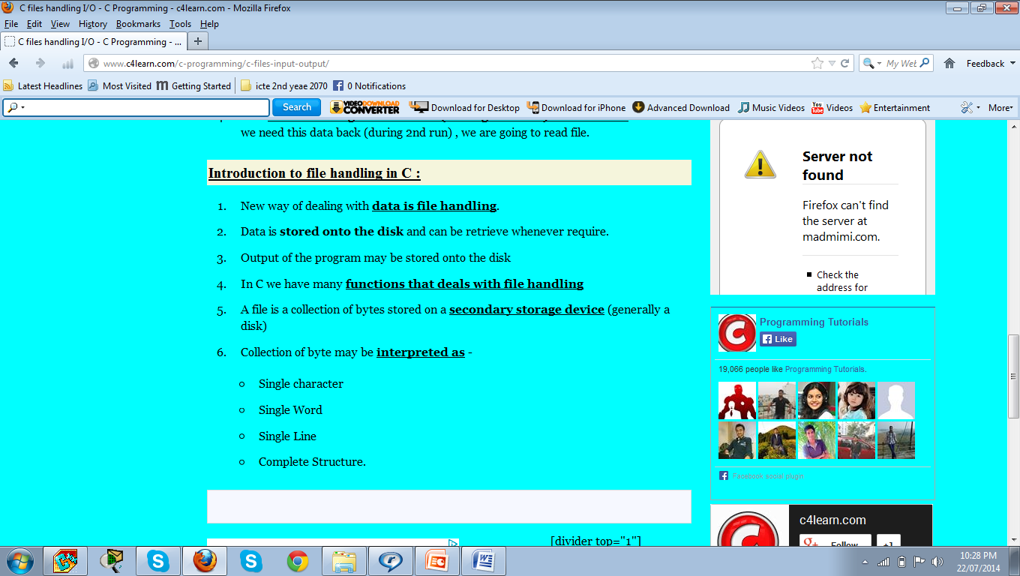

Slide 3
File Handling
In this section, we will discuss about files which are very important for storing information permanently. We store information in files for many purposes, like data processing by our programs.
Types of file:
There are two types of files.
1. Sequential File:
2. Random Access File:

Slide 4
What is a file?
A named collection of data, stored in secondary
storage (typically).
Typical operations on files:
– Open
– Read
– Write
– Close
• How is a file stored?
– Stored as sequence of bytes, logically contiguous (may not be
physically contiguous on disk).

Slide 5
File Operation
Creating a new file
Opening a file
Reading from a file
Writing to a file

Slide 6
Mode | Meaning
r | Used to open file for reading provided that the file must exist to read it.
w | Used for opening the file for writing. If the file exists, its contents will be erased and if the file doesn’t exist then it will be created.
a | Used for opening the file to append( to add content to the end of file) if the file exist but if the file doesn’t exist, the new file will be created and pointer will be at first i.e. 0 location for putting the content from the beginning of the file.
r+ | Used for opening the file for both reading and writing. The file must already exist before performing operation.
w+ | Used for opening file for both writing and reading. If the file exists, its contents are erased and if the file doesn’t exist, then it will be created.
a+ | Used for opening file for both reading and appending if the file exists, but if the file doesn’t exist, then new file will be created and pointer will be at first i.e. 0 location for putting the content from the beginning of the file.

Slide 7
Tips
The parameter function getchar()of while loops takes character from keyboard and place to character c
The putc() places the character c on the file pointer f.
The getc() is used to receive one single character from a data file
The putc() is used to place one single character to a data file.
The syntax of getc() and putc() are as follows:
getc (file_pointer)
Putc(character, file_pointer)

Slide 8
#include <stdio.h>
#include <conio.h>
void main()
{
FILE *fp;
fp=fopen("test1.txt","w");
fprintf(fp,"%s","creat & witing in file");
fclose(fp);
getch();
}

Slide 9
/* Program to display the contents of a file on screen */
#include <stdio.h>
#include <conio.h>
void main()
{
printf("Hello !My dear");
getch();
}
Notes:
This file save as fist of all (file name file.c)

Slide 10
#include <stdio.h>
#include <conio.h>
void main()
{
FILE *fp;
char ch;
fp=fopen("file1.c","r");
while(1)
{
ch=fgetc(fp);
if(ch==EOF)
break;
printf("%c",ch);
}
fclose(fp);
getch();
}
while(1) mean it is an infinite loop.we can stop it only through it a condition that use break stament.
/* Program to display the contents of a file on screen */
Notes:
while(1) ... body In this case, the expression is "1". The body executes repeatedly until 1 is found to be equal to zero. Of course, 1 will never be equal to 0 so the loop repeats forever.

Slide 11
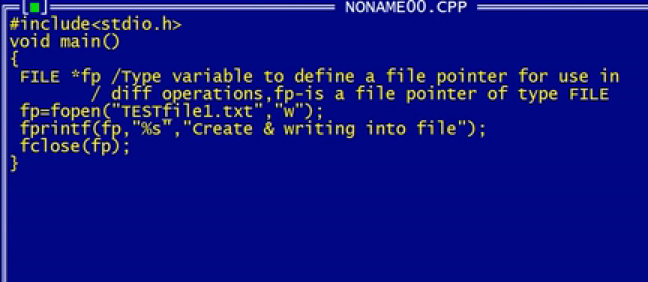
File handling

Slide 12
#include <stdio.h>
#include <conio.h>
void main()
{
FILE *fp;
fp = fopen("ict.txt","r");
char ch;
while(1)
{
ch=fgetc(fp);
if (ch==EOF)
break;
printf("%c",ch );
}
fclose(fp);
getch();
}
#include <stdio.h>
#include <conio.h>
void main()
{
FILE *fp;
fp = fopen("ict.txt","w");
if(fp== NULL)
printf("file not open");
else
printf("Congratularion:");
fclose(fp);
getch();
}

Slide 13
Here is a program that will add text to a file which already exists and there is some text in the file.
#include <stdio.h>
#include <conio.h>
int main()
{
FILE *fp;
fp=fopen("file.txt","a");
fprintf(fp,"%s","This is just an example :)"); /*append some text*/
fclose(fp);
getch();
}

